Slide 1
Empowering Learning for Social Inclusion through Occupation (ELSITO)
Sarah Kantartzis

Slide 2
European Union Life Long
Learning Programme
A Grundtvig Learning Partnership
Partners:
Hellenic Association of Occupational Therapists, Greece
GGZ in Geest partner VUmc,
The Netherlands
Hogeschool-Universiteit Brussel, Belgium

Slide 3
Working to develop social inclusion for persons with mental health problems, immigrants and refugees
Collaborating Partners:
Rusenski Universitet “Angel Kanchev”, Ruse, Bulgaria
Fundacio Universitaria Balmes, Vic, Spain
University of Teesside, UK
ENOTHE

Slide 4
A learning partnership
Learners are service users, staff, occupational therapists and occupational therapy students
Learning about social inclusion through international visits and local projects, sharing our lived experience
Learning about good practice in social inclusion, through:
- Descriptions of good practice
- Narratives of learners

Slide 5
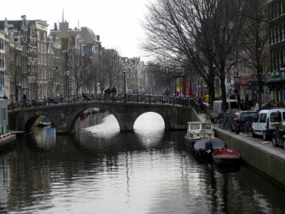
First Learning Visit:
Amsterdam, The Netherlands
March 2010

Slide 6
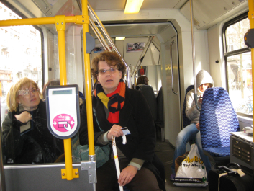
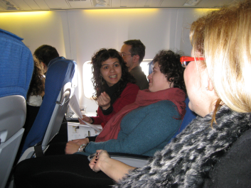
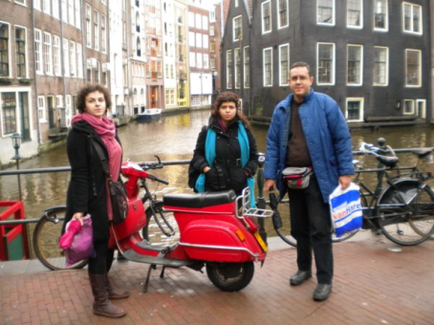
Travelling together

Slide 7
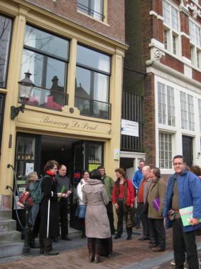
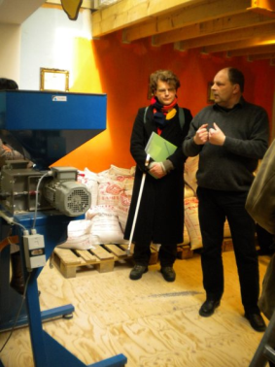
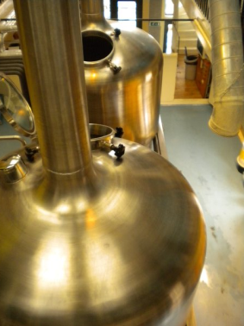
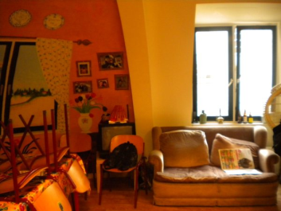
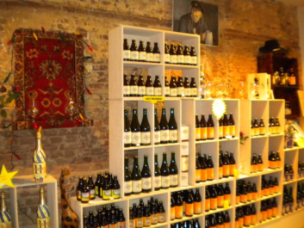
Visiting projects De Prael Brewery

Slide 8
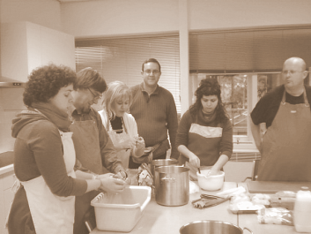
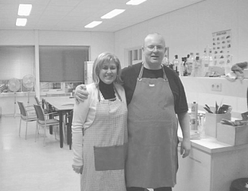
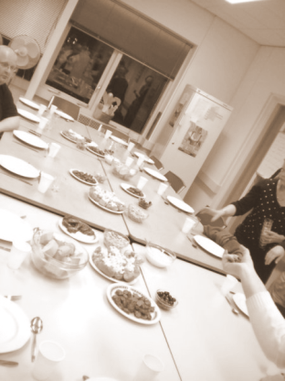
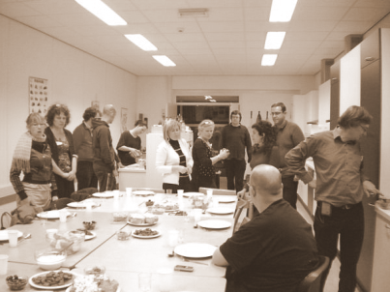
Cooking and eating together

Slide 9
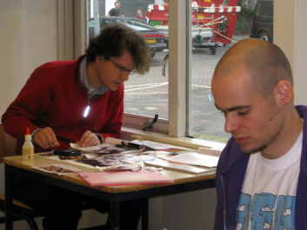
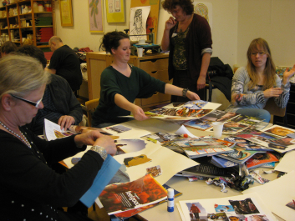
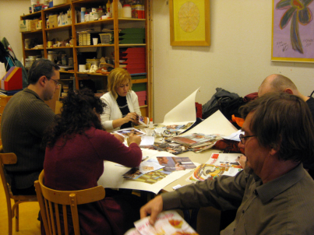
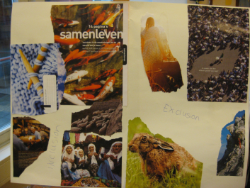
Experiences of social inclusion

Slide 10
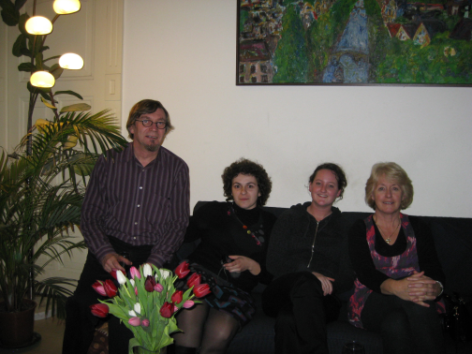
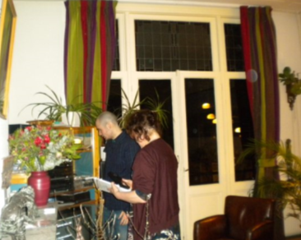
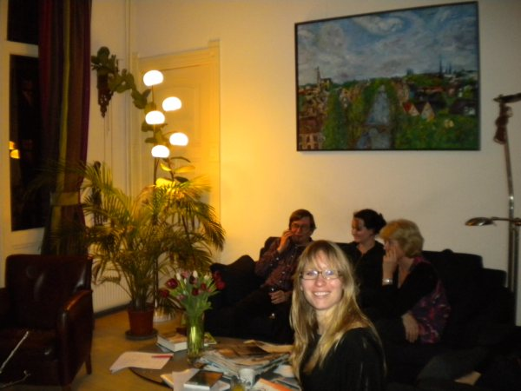
Invited for dinner

Slide 11
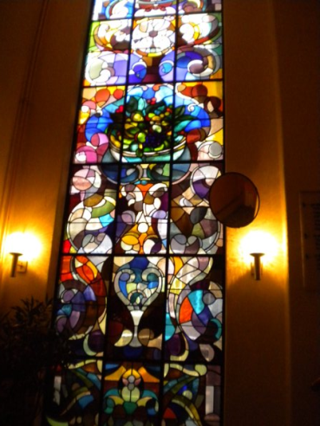
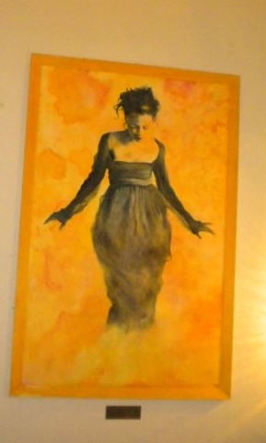
Narratives

Slide 12
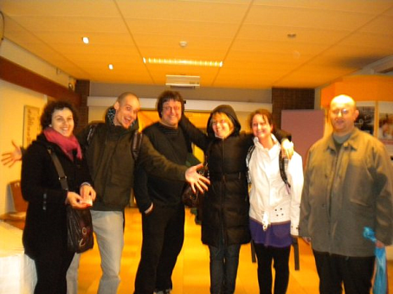
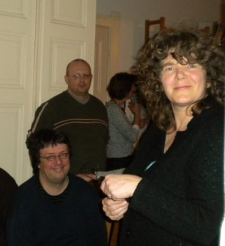
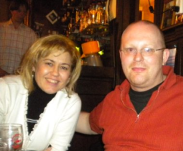
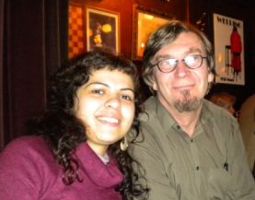
New friends

Slide 13
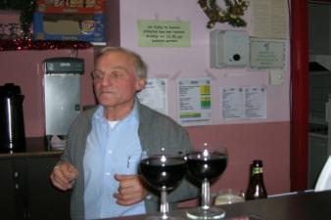
Café “Pol parol” meeting place in Leuven, Belgium
Aiming to empower and encourage the clients of the café (mental health clients, neighbourhood inhabitants) to engage as volunteers in the running and management of this meeting place, as a place for active encounters for all participants.
Hogeschool-Universiteit Brussel, Belgium

Slide 14
Mental Health Organization,
Department Day Activities and Work
Aiming for societal participation and inclusion
Projects:
«The Healthy Bite»
«The Network Table»
«The Sport’s Project»
GGZ in Geest partner VUmc, Amsterdam, The Netherlands

Slide 15
Special Interest Group for
Social Inclusion
Members are working to develop projects with:
The Panhellenic Association for Psychosocial Rehabilitation and Re-employment
The Municipality of Heraklion Attika, the Social Political Department
Hellenic Association of Occupational Therapists, Athens, Greece

Slide 16
Narratives of learners
Process of recovery
Critical learning moments
Available on website

Slide 17
Results:
Descriptions of good practice
Narratives of learners
Identification of learning processes
Identification of competences
Website and booklet

Slide 18
ELSITO:
an example of good practice
Mutual learning between all involved
Experiencing inclusion during visits
Range of projects
Narratives of experiences
Multi-disciplinary
Local and international networks

Slide 19
The website
www.elsito.net
We invite you to add your descriptions of good practice and your stories (narratives)
Exchange experiences, learn more about ELSITO, find information on social inclusion, recovery

Slide 20
Thank you

