Slide 1
Empowering Learning for Social Inclusion through Occupation (ELSITO)
Salvador Simo Algado
Sarah Kantartzis Marion Ammeraal, Luc Vercruysse,
Liliya Todorova, Hanneke van Bruggen

Slide 2
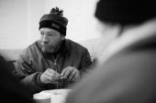
Europe today
90 million people facing poverty
Poor access to education, work, adequate living conditions, recreation and leisure activities
Health inequalities between rich and poor
People with disability particularly vulnerable

Slide 3
Europe today
50 million disabled (10%)
30% of citizens-longstanding health problems
10% mental/emotional problems
(EDF, 2010; EU, 2007, MH Social Inclusion Project)
Mental Health Problems
-consistently associated with unemployment, less education, low income, poor physical health and adverse life events.
- Prejudice, stigma and discrimination
- Isolation and social exclusion

Slide 4
Europe today
Immigrants form 10%-20% of the population
246,000 applications for asylum in 2009
Estimated 500.000 illegal immigrants enter Europe each year
(International Centre for Migrants)

Slide 5
WHO principles of action
Improve the conditions of daily life – the circumstances in which people are born, grow, live, work and age,
Tackle the inequitable distribution of power, money and resources – the structural drivers of conditions of daily life – globally, nationally and locally
Measure and understand the problem and assess the impact of action, educate professionals and public

Slide 6
WFOT Position statement on human rights
People have the right to participate in a range of occupations,
through occupation to be included and valued as members of their family, community and society
Work to achieve an occupationally just society

Slide 7
Existing health systems, diagnosis/deficit focus
Hierarchical model of service delivery
Competences
Stigma
Multi-dimensional approaches
Partnership learning
Share knowledge
Develop competences
Recovery, citizenship and human rights

Slide 8
European Union Life Long
Learning Programme
A Grundtvig Learning Partnership
Partners:
Hellenic Association of Occupational Therapists, Greece
GGZ in Geest partner VUmc,
The Netherlands
Hogeschool-Universiteit Brussel, Belgium

Slide 9
Working to develop social inclusion for persons with mental health problems, immigrants and refugees
Collaborating Partners:
Rusenski Universitet “Angel Kanchev”, Ruse, Bulgaria
Fundacio Universitaria Balmes, Vic, Spain
University of Teesside, UK
ENOTHE

Slide 10
A learning partnership
Learners are service users, staff, occupational therapists and occupational therapy students
Learning about social inclusion through international visits and local projects, sharing our lived experience
Learning about good practice in social inclusion, through:
- Descriptions of good practice
- Narratives of learners

Slide 11
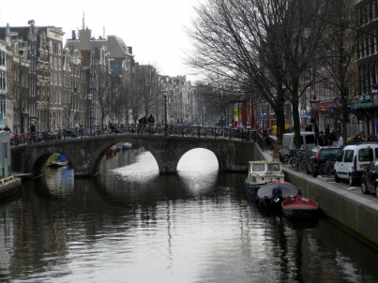
First Learning Visit:
Amsterdam, The Netherlands
March 2010

Slide 12
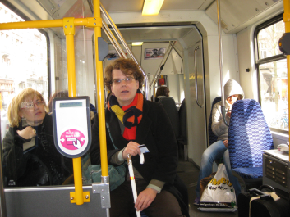
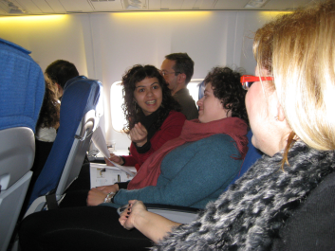
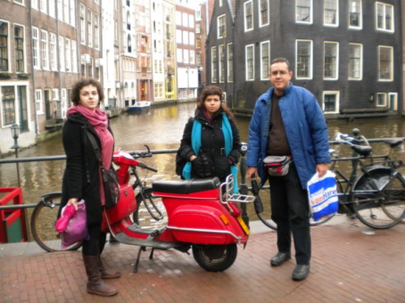
Travelling together

Slide 13
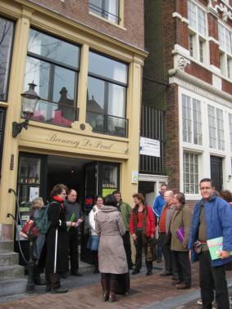
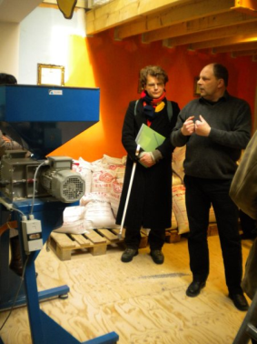
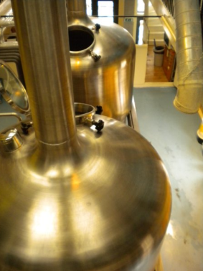
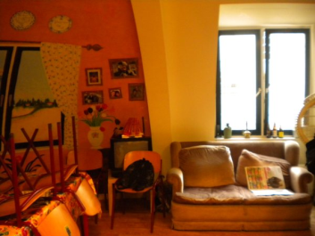
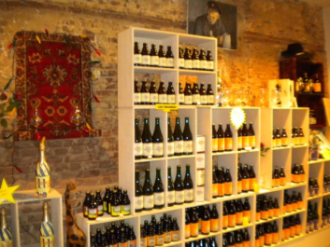
Visiting projects De Prael Brewery

Slide 14
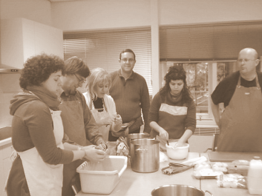
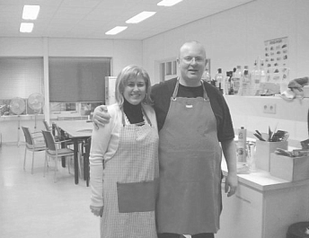
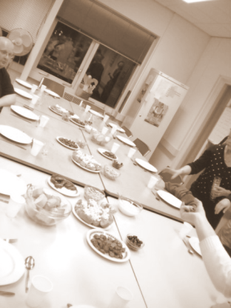
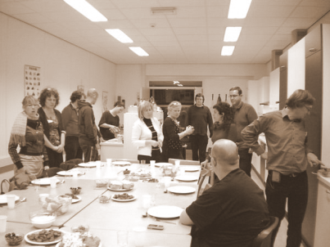
Cooking and eating together

Slide 15
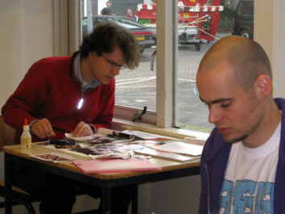
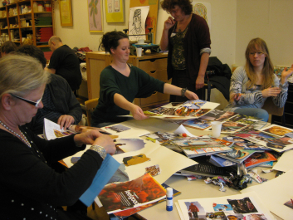
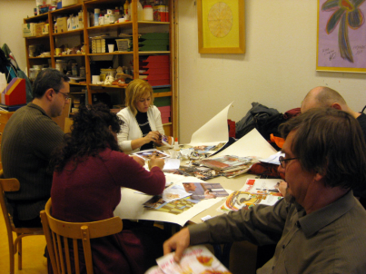
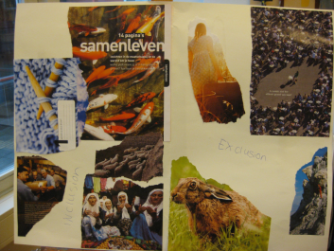
Experiences of social inclusion

Slide 16
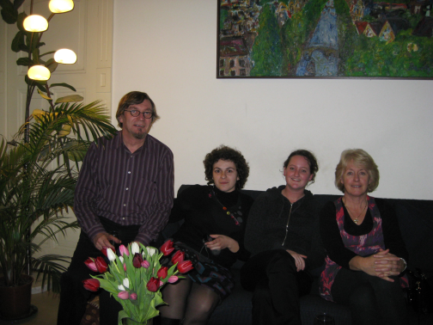
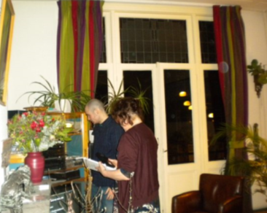
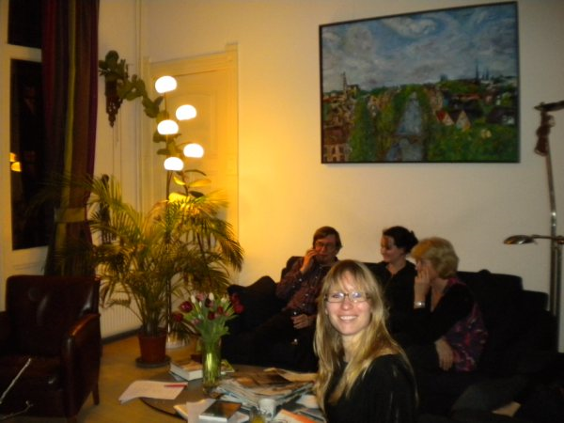
Invited for dinner

Slide 17
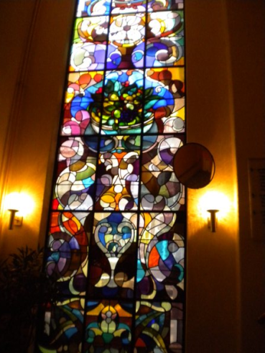
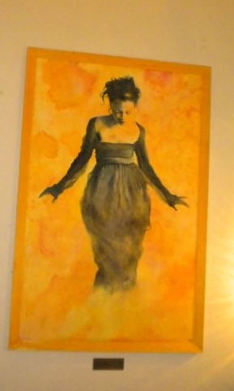
Narratives

Slide 18
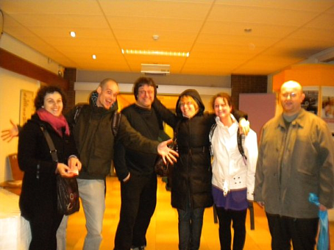
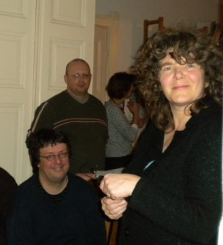
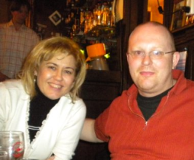
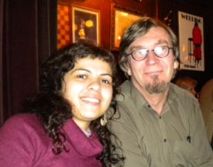
New friends

Slide 19
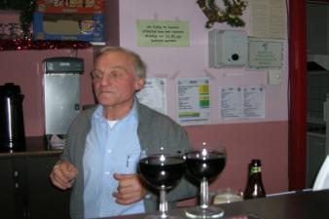
Café “Pol parol” meeting place in Leuven, Belgium
Aiming to empower and encourage the clients of the café (mental health clients, neighbourhood inhabitants) to engage as volunteers in the running and management of this meeting place, as a place for active encounters for all participants.
Hogeschool-Universiteit Brussel, Belgium

Slide 20
Mental Health Organization,
Department Day Activities and Work
Aiming for societal participation and inclusion
Projects:
«The Healthy Bite»
«The Network Table»
«The Sport’s Project»
GGZ in Geest partner VUmc, Amsterdam, The Netherlands

Slide 21
Special Interest Group for
Social Inclusion
Members are working with:
The Panhellenic Association for Psychosocial Rehabilitation and Re-employment
The Municipality of Heraklion Attika, the Social Political Department
Hellenic Association of Occupational Therapists, Athens, Greece

Slide 22
Descriptions of projects
How did the project begin?
Examples of questions from Template
4. What do you do in this project (activities, occupations)?
5. How did this project begin?
8. How do you decide if this project is working well and what needs changing?
9. How much does it cost to run this project and how is it funded?

Slide 23
Narratives of learners
Process of recovery
Critical learning moments
Available on website

Slide 24
Results:
Descriptions of good practice
Narratives of learners
Identification of learning processes
Identification of competences
Website and booklet

Slide 25
The website: www.elsito.net
We invite you to add your descriptions of good practice and your stories (narratives)
Exchange experiences, learn more about ELSITO, find information on social inclusion, recovery
COME AND JOIN US

Slide 26
Thank you

